Slide 1
EDA CONTEST
SALES ANALYSIS PROJECT
Name: Jay Ganesh Charole
Email: jaycharole@gmail.com

Slide 2
CONTENTS
About the project
About the Data
Insights to find?
1
A detailed description about the project.
2
Introduction to data set that is been used for project.
3
What are the objectives and insights that are to be found out?
Steps for EDA and cleaning data
Visual analytics
Key Findings
4
Various steps used for data cleaning and EDA process.
5
Different visuals and summaries to understand data well
6
Insights we found out according to various questions.
Dashboard view
7
The view of dashboard that is been created

Slide 3
1
ABOUT THE PROJECT

Slide 4
ABOUT PROJECT
Every company has a HR Department which deals with various recruitment and placement related work of the company. Here in this project we have a huge data set in from which we are going to extract insights which can be useful for HR department to work on and to gain knowledge about the recruitment process of the market. We have extracted many different insights which we will observe further in the report.

Slide 5
2
ABOUT THE DATA

Slide 6
ABOUT DATA SET
The dataset is about the job details data for analytics industry. The companies in the dataset are Hong Kong based companies. Data consist of various job description for various analytics job roles like Data Scientist, Data analyst, Business Intelligence, Machine Learning Engineer, Data Engineer. The Dashboard made at the end is for the HR Team of a company.
The dataset has 6 separate dataset of different days which was combined to make a final data set. It is a huge dataset with many columns and other attributes

Slide 7
DETAILS OF DATASET
1
JOB TITLE
The Job Title column contains the name of the jobs given by a particular company.
2
COMPANY
The Company column contains the name of the companies who are providing different types of jobs.
3
SALARY
The Salary column contains the salary for various job roles. Salary column has many null values as many companies do not reveal their salaries publicly.
4
JOB DESCRIPTION
The Job Description column contains the detailed description of the job given by particular companies providing the jobs.
5
CAREER LEVEL
The column contains various career levels like Entry Level, middle level, senior level, etc. based on number of years of experience.

Slide 8
DETAILS OF DATASET
6
QUALIFICATION
The Qualification column contains various educational qualification an individual need for a job for example degree, graduation, post graduation, etc.
7
YEARS OF EXPERIENCE
The Years of Experience column contains the minimum eligibility in terms of experience of years for various job roles
8
JOB TYPE
The Job Type column contains the type of jobs required for example full time, internship, part time, contract, etc.
9
COMPANY WEBSITE
In the company website there are various website links where an individual can apply.
10
INDUSTRY
The Industry column is the domain to which a particular job role belongs for example Finance, HR, IT, etc.

Slide 9
DETAILS OF DATASET
11
SEARCH TERM
The Search Term is the column which contains various analytics domain job belongs to for example Data Science, Data Analytics, BI, ML, etc.
12
DATE POSTED
The Date posted column contains the date when a particular job was posted.
13
DATE SCRAPPED
The Date scrapped column contains the date when the particular dataset was scrapped from some recruitment websites..

Slide 10
INSIGHTS TO
FIND OUT?
3

Slide 11
INSIGHTS TO BE FOUND?
1
What are total number of jobs available?
2
What are total number of companies providing jobs?
3
What are total jobs for various domains?
4
What are various career level and it’s distribution across various jobs?
5
What are distribution of jobs across various analytics fields?

Slide 12
INSIGHTS TO BE FOUND?
6
Which company is providing highest number of jobs?
7
Which domain has the highest number of jobs?
8
What are minimum required qualification for job roles?
9
What are various job types for different job titles?
10
Which are TOP 5 companies with highest jobs?

Slide 13
STEPS FOR CLEANING DATA AND EDA
4

Slide 14
1. REMOVING UNECESSARY COLUMNS
1
REMOVING LOWER SALARY RANGE & UPPER SALARY RANGE
The column is of no use hence we can replace the columns using remove column option of Power BI.
2
REMOVING DATE SOURCE COLUMN
The column is of no use hence we can replace the columns using remove column option of Power BI.

Slide 15
2. REMOVING NULL VALUES AND ERRORS
1
REMOVING NULL VALUES AND ERRORS AND MISSING VALUES FROM COLUMNS
There are various null values, errors and missing values in the columns which we can delete using various options in Power BI.
2
REMOVING NOT SPECIFIED VALUES FROM THE COLUMNS
There are many columns which has the value Not Specified values which are of no use and can create problem while changing data types and other calculations hence we will remove that values from the data set.

Slide 16
3. CHANGING DATA TYPES
1
CHANGING DATA TYPE OF YEAR OF EXPERIENCE
The column was having a string data type hence we can change it to whole number using change data type option.
2
CHANGING DATA TYPE OF DATE COLUMNS The data formats were in string type hence we have changed it to date type using change data type option

Slide 17
4. REPLACING VALUES
1
REPLACING VALUES IN EXPERIENCE COLUMN
The Experience table was having a value -1 which was suppose to be 1 so changed the value -1 to 1 using Replace Value option.
2
REPLACING VALUE IN QUALIFICATION COLUMN
The Qualification column has two qualification name Non-Degree Tertiary and Non Degree Tertiary so we can replace Non Degree Tertiary with Non-Degree Tertiary as they represent same qualification.
3
JOB TYPE
The Job Type column contains the type of jobs required for example full time, internship, part time, contract, etc.

Slide 18
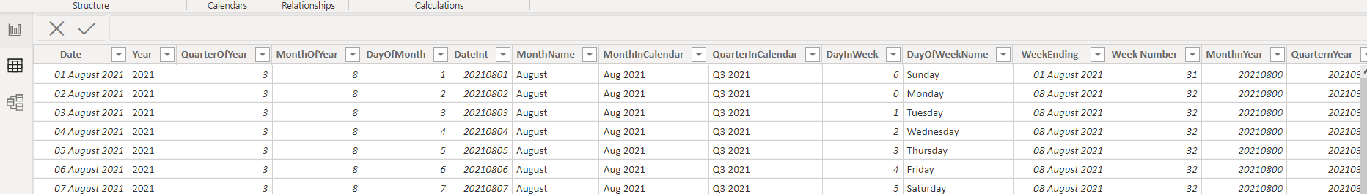
5. CREATING DATE TABLE USING M LANGUAGE
1
CREATING DATE TABLE USING M LANGUAGE
We need a date table to perform date operations hence we can create Date Table using the following code.

Slide 19
VISUAL ANALYTICS AND FINDINGS
5

Slide 20
SUMMARY OF DATA
Total sales
Total Profit
2.3M
283.2K
Total Quantity
30.4K

Slide 21
SUMMARY OF DATA
Total Transactions
Profit Margin
8.0K
12.1%
Total Customers
792

Slide 22
5
OVERALL ANALYSIS

Slide 23
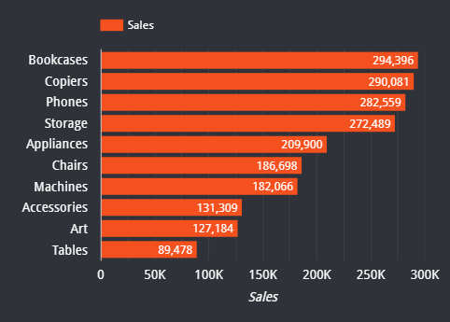
CATEGORY WISE OVERALL SALES ANALYSIS
Total Sales
2.3M
KEY INSIGHTS
The overall total sales are 2.3 M.
According to the graph Bookcases has the highest sales with 294,296. and the lowest is for Tables 89,478.

Slide 24
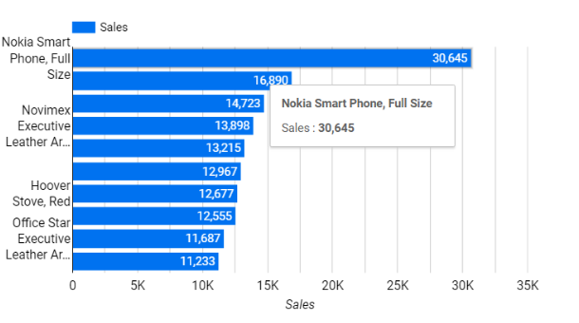
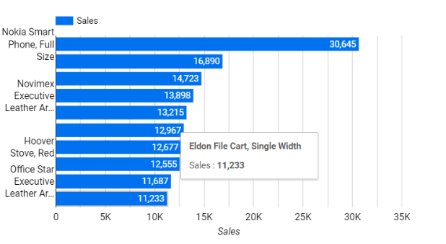
PRODUCT WISE OVERALL SALES ANALYSIS
KEY INSIGHTS
For the products the sales is highest for Nokia Smart Phone, Full size and the sales is lowest for Eldon File Cart, Single width.

Slide 25
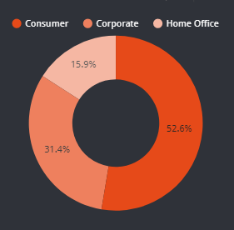
SEGMENT WISE OVERALL SALES ANALYSIS
KEY INSIGHTS
In segment wise sales analysis the highest percentage of sales is in Consumer segment i.e. 52.6% and the lowest percentage of sales is in Home Office i.e. 15.9%.

Slide 26
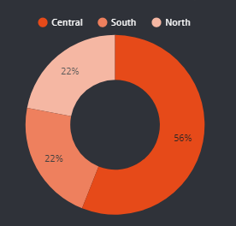
REGION WISE OVERALL SALES ANALYSIS
KEY INSIGHTS
For the region wise sales analysis. The highest is for Central region i.e. 56% and the both South and North shares same percentage of sales i.e. 22%.

Slide 27
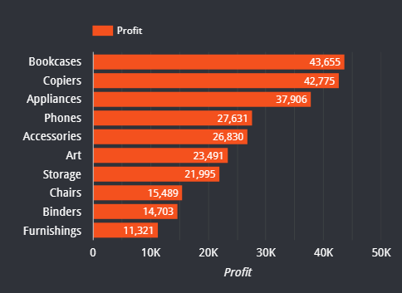
CATEGORY WISE OVERALL PROFIT ANALYSIS
Total Profit
283.2K
KEY INSIGHTS
The overall total profit are 283.2K
According to the graph Bookcases has the highest profit with 43,655 and the lowest is for Furnishings 11,321.

Slide 28
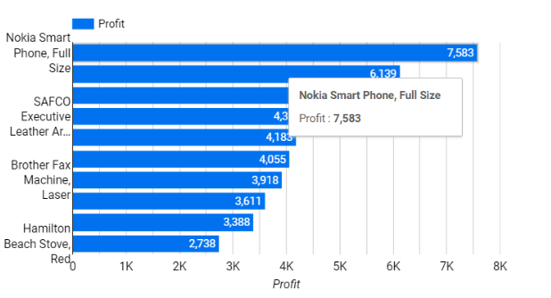
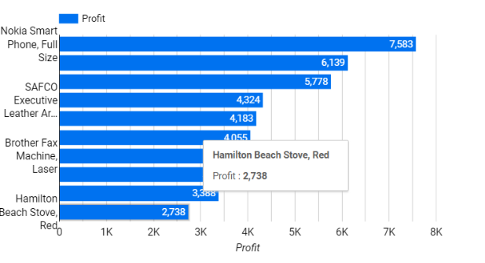
PRODUCT WISE OVERALL PROFIT ANALYSIS
KEY INSIGHTS
For the products the profit is highest for Nokia Smart Phone, Full size and the sales is lowest for Hamilton Beach Stove, Red.

Slide 29
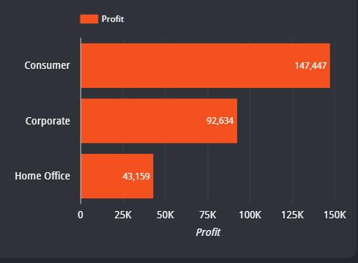
SEGMENT WISE OVERALL PROFIT ANALYSIS
KEY INSIGHTS
According to the visual the profit for consumer is highest and that of Home office is the lowest.

Slide 30
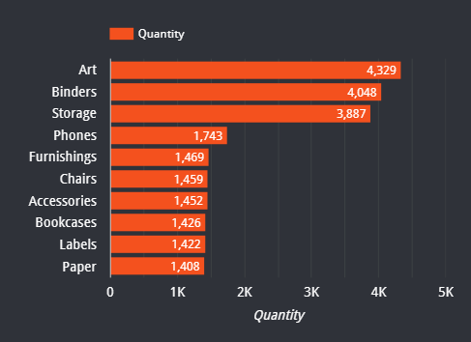
CATEGORY WISE OVERALL QUANTITY ANALYSIS
Total Quantity
30.4K
KEY INSIGHTS
The overall Total Quantity is 30.4 K.
According to the graph Art category has the highest quantity and the lowest is for Paper.

Slide 31
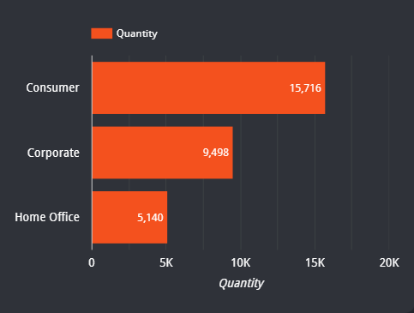
SEGMENT WISE OVERALL QUANTITY ANALYSIS
KEY INSIGHTS
According to the visual the Quantity for consumer is highest and that of Home office is the lowest.

Slide 32
SEGEMENT WISE ANALYSIS
5

Slide 33
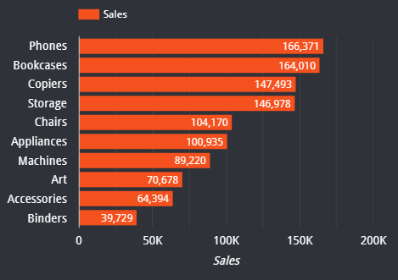
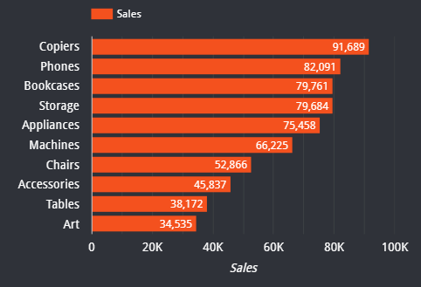
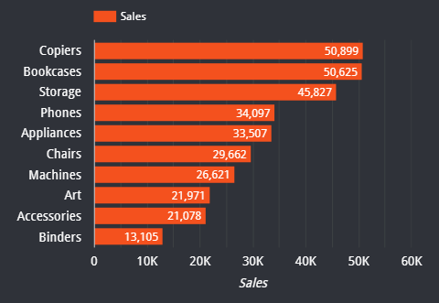
SALES ANALYSIS OF CATEGORIES IN VARIOUS SEGMENTS
HOME OFFICE
CORPORATE
CONSUMER
KEY INSIGHTS
According to the above visual, in Home Office segment the Phones is the category which has highest sales and Binders is the category which has lowest sales.
KEY INSIGHTS
According to the above visual, in Corporate segment the Copiers is the category which has highest sales and Art is the category which has lowest sales.
KEY INSIGHTS
According to the above visual, in Consumer segment the Copiers is the category which has highest sales and Binders is the category which has lowest sales.

Slide 34
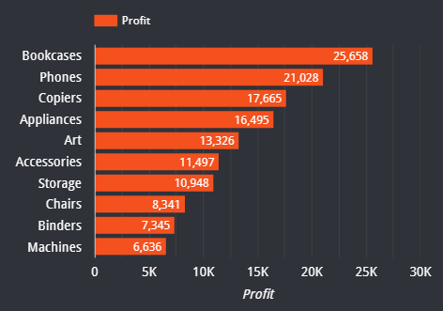
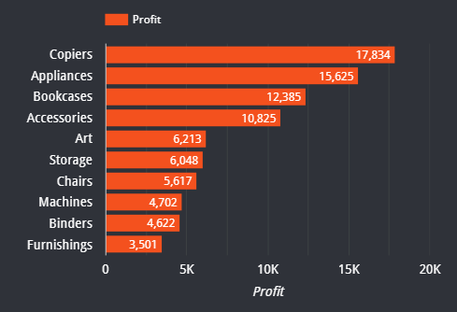
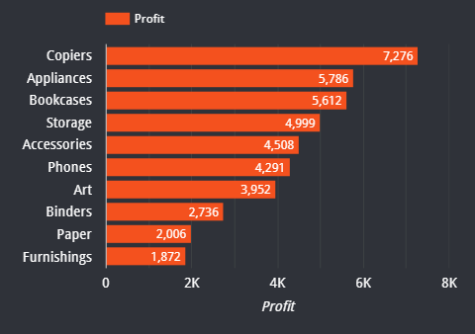
PROFIT ANALYSIS OF CATEGORIES IN VARIOUS SEGMENTS
HOME OFFICE
CORPORATE
CONSUMER
KEY INSIGHTS
According to the above visual, in Home Office segment the Bookcases is the category which has highest Profit and Machines is the category which has lowest profit.
KEY INSIGHTS
According to the above visual, in Corporate segment the Copiers is the category which has highest profit and Furnishing is the category which has lowest profit.
KEY INSIGHTS
According to the above visual, in Consumer segment the Copiers is the category which has highest profit and Furnishing is the category which has lowest profit.

Slide 35
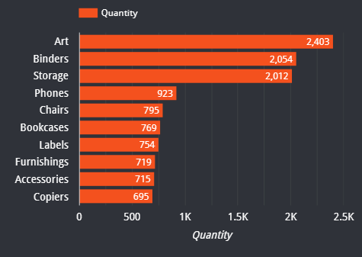
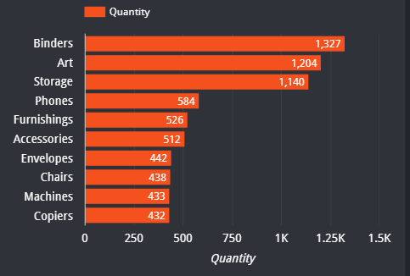
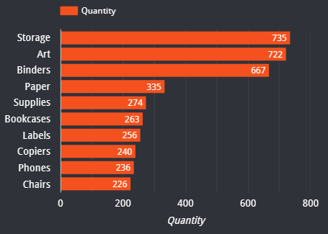
QUANTITY ANALYSIS OF CATEGORIES IN VARIOUS SEGMENTS
HOME OFFICE
CORPORATE
CONSUMER
KEY INSIGHTS
According to the above visual, in Home Office segment the Art is the category which has highest quantity and Copiers is the category which has lowest quantity.
KEY INSIGHTS
According to the above visual, in Corporate segment the Binders is the category which has highest quantity and Copiers is the category which has lowest quantity.
KEY INSIGHTS
According to the above visual, in Consumer segment the Storage is the category which has highest quantity and Chairs is the category which has lowest quantity.

Slide 36
REGION WISE ANALYSIS
5

Slide 37
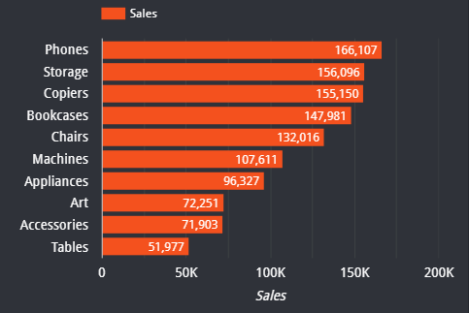
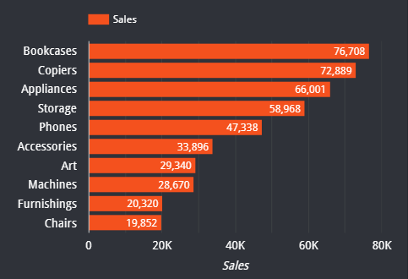
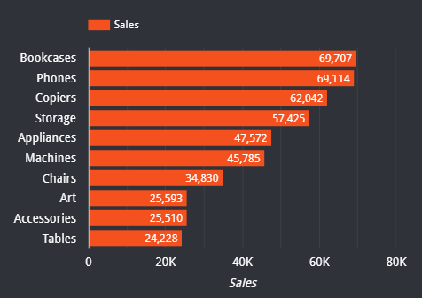
SALES ANALYSIS OF CATEGORIES IN VARIOUS REGIONS
CENTRAL
SOUTH
NORTH
KEY INSIGHTS
According to the above visual, in Central Region the Phones is the category which has highest sales and Tables is the category which has lowest sales.
KEY INSIGHTS
According to the above visual, in South Region the Bookcases is the category which has highest sales and Chairs is the category which has lowest sales.
KEY INSIGHTS
According to the above visual, in North Region the Bookcases is the category which has highest sales and Tables is the category which has lowest sales.

Slide 38
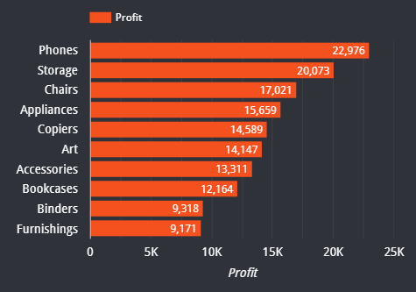
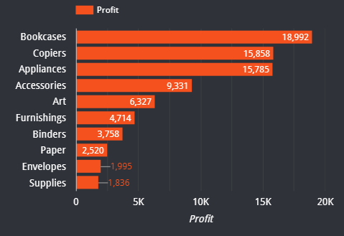
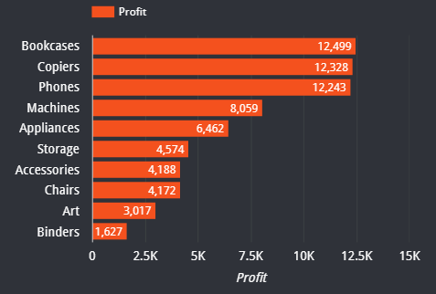
PROFIT ANALYSIS OF CATEGORIES IN VARIOUS REGIONS
CENTRAL
SOUTH
NORTH
KEY INSIGHTS
According to the above visual, in Central Region the Phones is the category which has highest profit and Furnishing is the category which has lowest profit.
KEY INSIGHTS
According to the above visual, in South Region the Bookcases is the category which has highest profit and Supplies is the category which has lowest profit.
KEY INSIGHTS
According to the above visual, in North Region the Bookcases is the category which has highest profit and Binders is the category which has lowest profit.

Slide 39
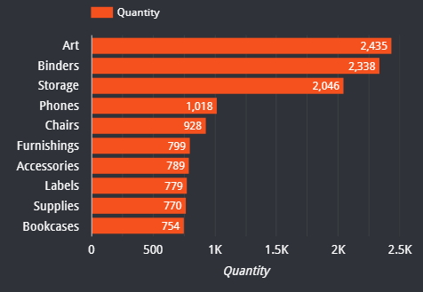
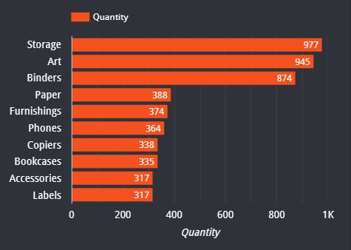
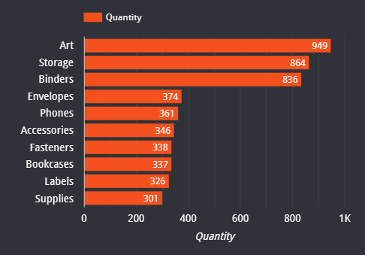
QUANTITY ANALYSIS OF CATEGORIES IN VARIOUS REGIONS
CENTRAL
SOUTH
NORTH
KEY INSIGHTS
According to the above visual, in Central Region the Art is the category which has highest quantity and Bookcases is the category which has lowest quantity.
KEY INSIGHTS
According to the above visual, in South Region the Storage is the category which has highest quantity and Labels is the category which has lowest quantity.
KEY INSIGHTS
According to the above visual, in North Region the Art is the category which has highest quantity and Supplies is the category which has lowest quantity.

Slide 40
5
COUNTRY ANALYSIS

Slide 41
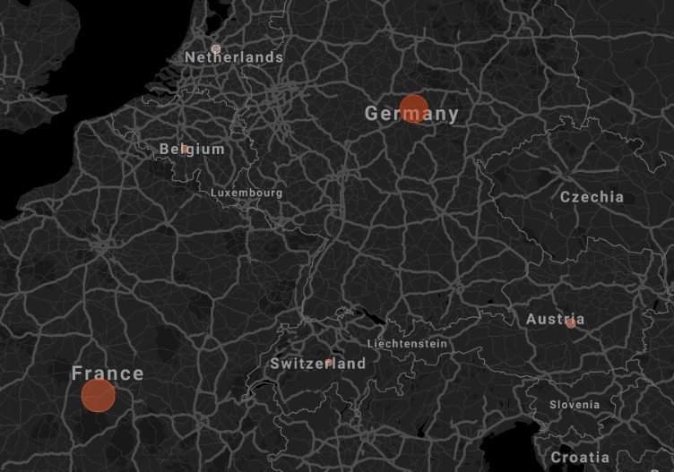
SALES AND PROFIR ANALYSIS ACROSS
VARIOUS COUNTRIES
No | Country | Sales | Profit
1 | Germany | 6,09,683 | 70,067
2 | France | 4,88,681 | 86,279
3 | Netherlands | 70,213 | -37,188
4 | Switzerland | 24,874 | 7,234
5 | Belgium | 43,200 | 9,912
6 | Austria | 79,382 | 21,332
KEY INSIGHTS
From the above table we can say that sales is highest in Germany and lowest in Switzerland.
Whereas the Profit is highest in France and lowest in Netherlands.

Slide 42
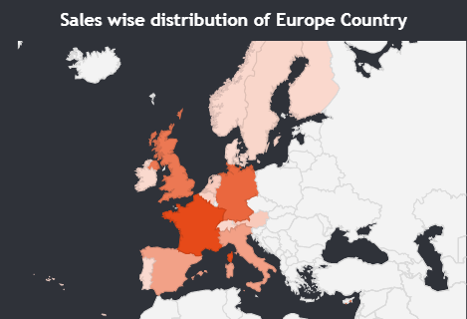
SALES ANALYSIS IN EUROPEAN COUNTRIES
KEY INSIGHTS
The sales is highest in France whereas in Ireland it is lowest
Ireland
Sales: 15,998
France
Sales: 609,683

Slide 43
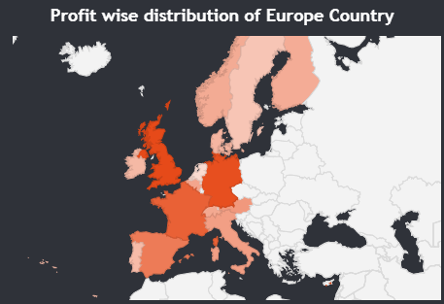
PROFIT ANALYSIS IN EUROPEAN COUNTRIES
KEY INSIGHTS
According to the visual the Profit is Highest in United Kingdom (U.K) and Least in Netherlands.
Netherlands
Profit: -37,188
United Kingdom
Profit: 90,382

Slide 44
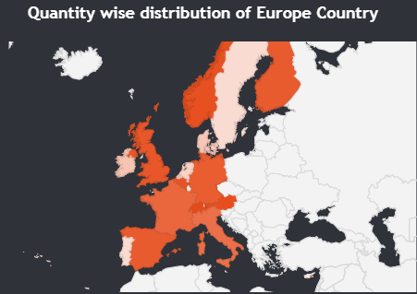
PROFIT MARGIN ANALYSIS IN
EUROPEAN COUNTRIES
KEY INSIGHTS
The Profit Margin is highest in Norway whereas it is lowest in Netherlands.
Norway
Sales: 0.25
Netherlands
Profit Margin: -0.53

Slide 45
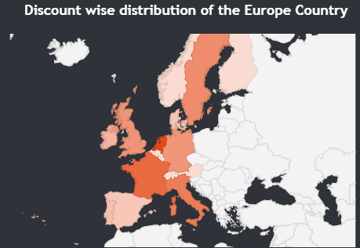
DISCOUNT ANALYSIS IN EUROPEAN COUNTRIES
KEY INSIGHTS
The Discount is highest in Netherlands whereas it is lowest in Finland.
Finland
Discount: 0
Netherlands
Discount: 188.9

Slide 46
5
OTHER ANALYSIS

Slide 47
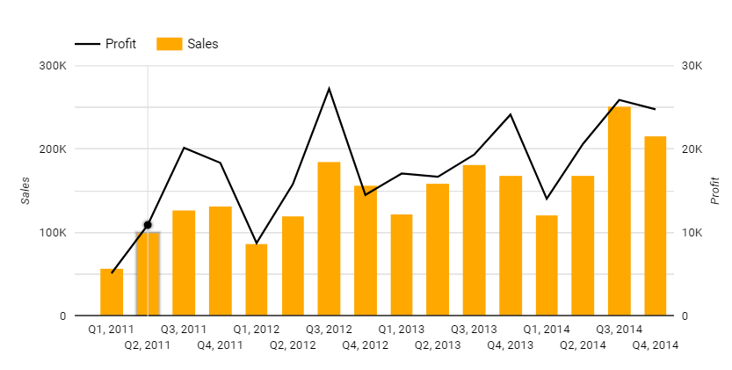
QUATERLY SALES AND PROFIT ANALYSIS
KEY INSIGHTS
According to above visual the sales in highest in 3rd Quarter of 2014 and lowest in 1st Quarter of 2011.
Profit is highest in 3rd Quarter of 2012 whereas lowest in the 1st Quarter of 2011.

Slide 48
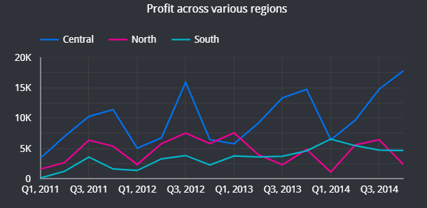
PROFIT ACROSS VARIOUS REGIONS
KEY INSIGHTS
According to the above visual
Central region has the highest profit in 3rd quarter of 2014 and lowest is in 1st quarter of 2012.
The North region has the highest profit in 1st Quarter of 2013 and lowest in 1st Quarter of 2014.
South region has the highest profit in 1st Quarter of 2014 and lowest in 1st Quarter of 2011.

Slide 49
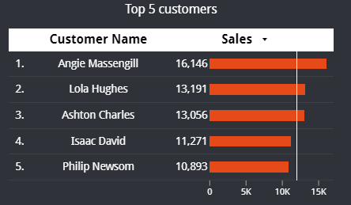
TOP 5 CUSTOMERS
KEY INSIGHTS
The overall total sales are 2.3 M.
According to the graph Bookcases has the highest sales with 294,296. and the lowest is for Tables 89,478.

Slide 50
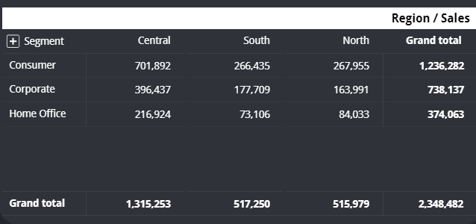
REGION VS SEGMENT SALES ANALYSIS
KEY INSIGHTS
The overall total sales are 2.3 M.
According to the graph Bookcases has the highest sales with 294,296. and the lowest is for Tables 89,478.

Slide 51
6
KEY INSIGHTS

Slide 52
INSIGHTS TO BE FOUND?
1
There are 1979 jobs available.
2
719 companies are providing jobs.
There are around 50 different domains in which jobs are provided
3
4
HKT and Michael Page are the companies which has highest job opening.
5
Human Resources Management/Consulting is the domain which has highest number of jobs.

Slide 53
INSIGHTS TO BE FOUND?
6
Middle level jobs has the highest opening with 1014 jobs.
Data Science has highest job titles followed by Data analyst.
7
8
ML Engineer has the least job titles.
9
Most companies prefer individuals with degree for their job roles
10
Most job types are temporary contract based.

Slide 54
7
DASHBOARD

Slide 55
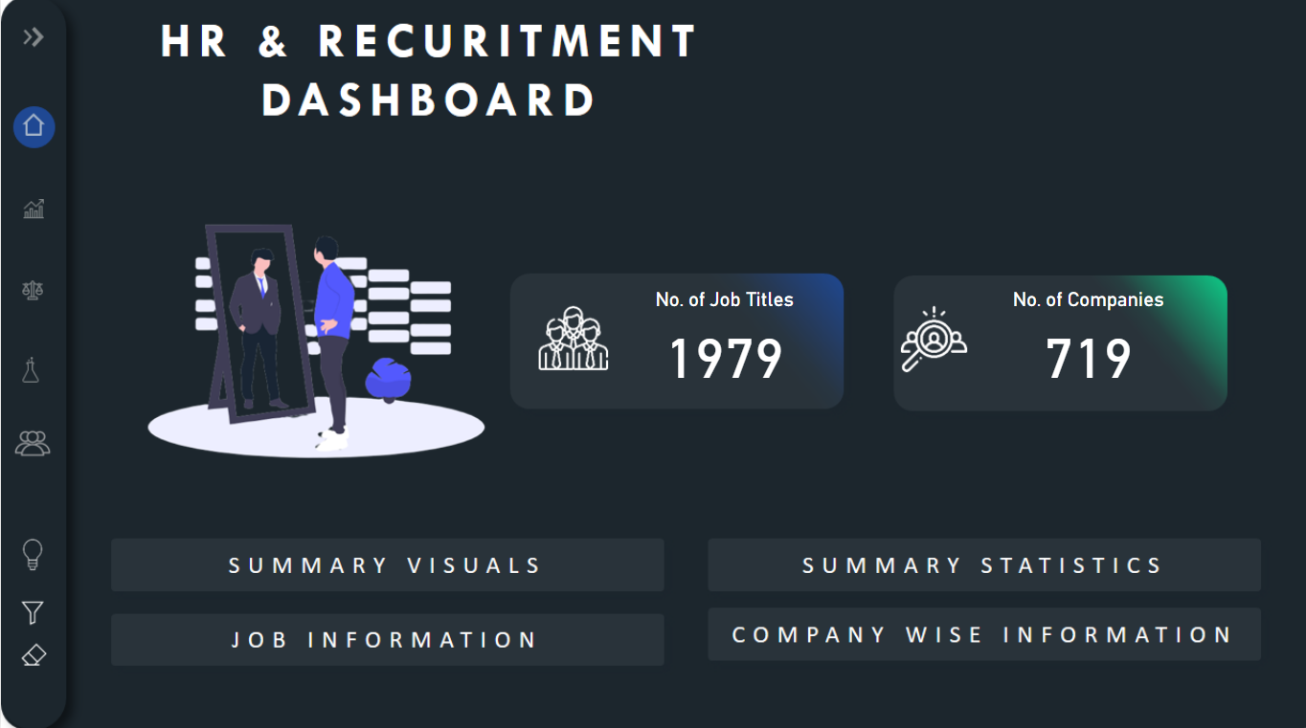
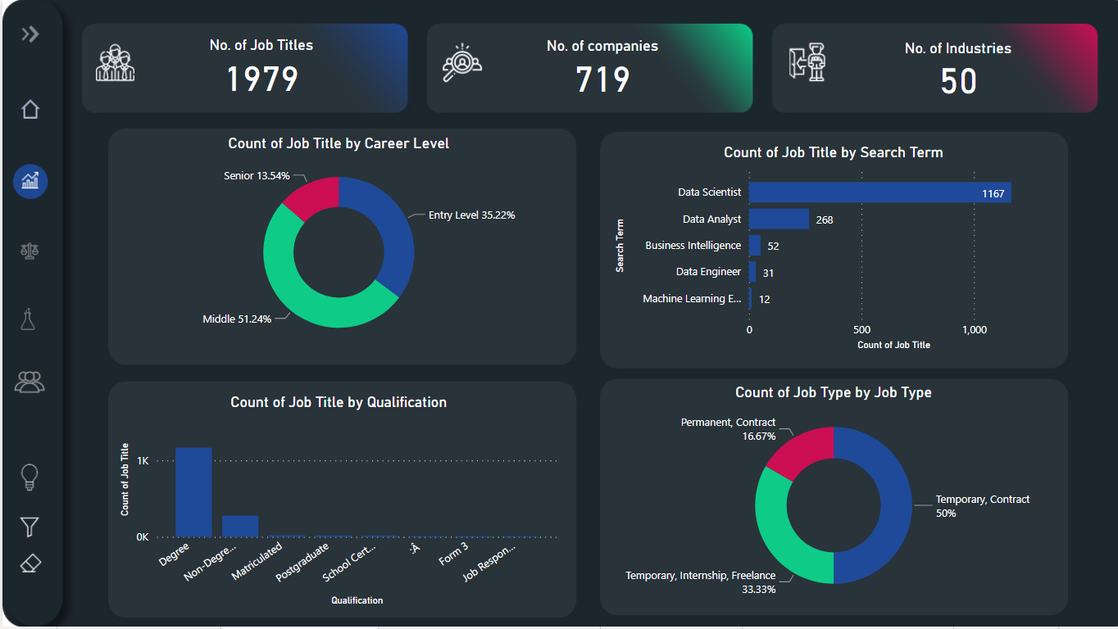
DASHBOARD PAGES VIEW
HOME PAGE OF THE DASHBOARD
SUMMARY VISUAL PAGE

Slide 56
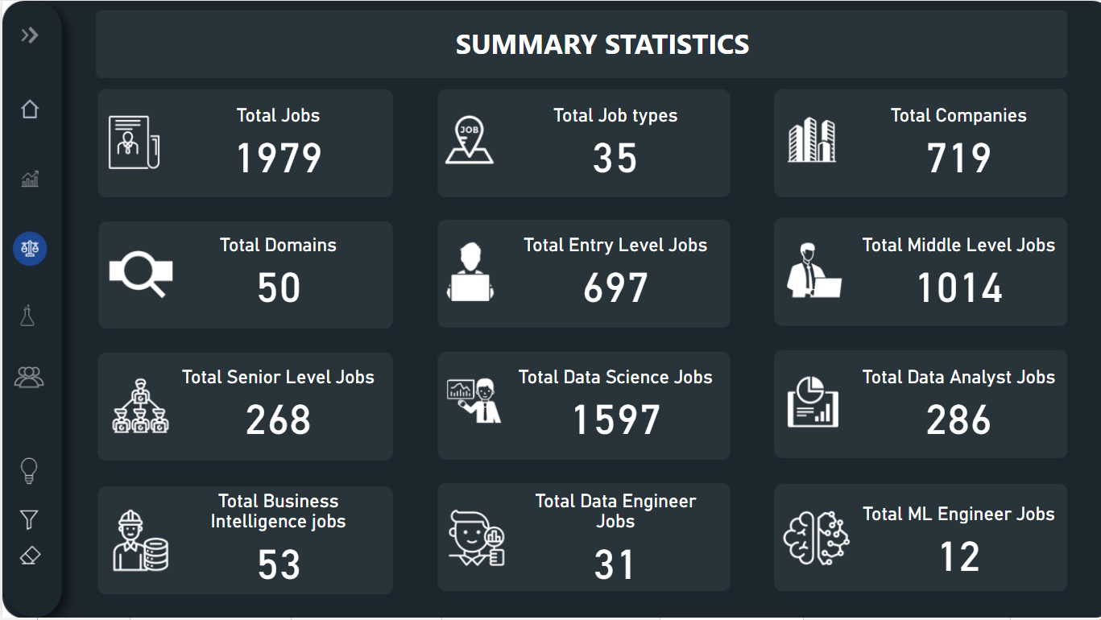
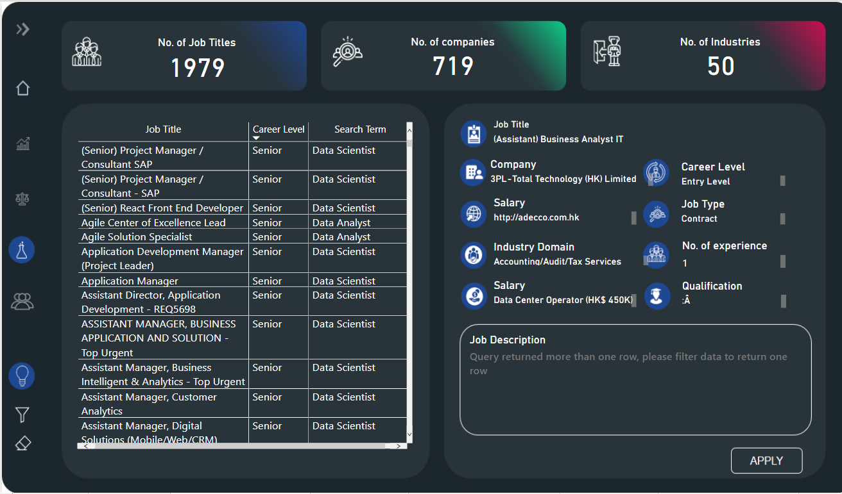
DASHBOARD PAGES VIEW
SUMMARY STATISTICS PAGE
JOB SUMMARY PAGE

Slide 57
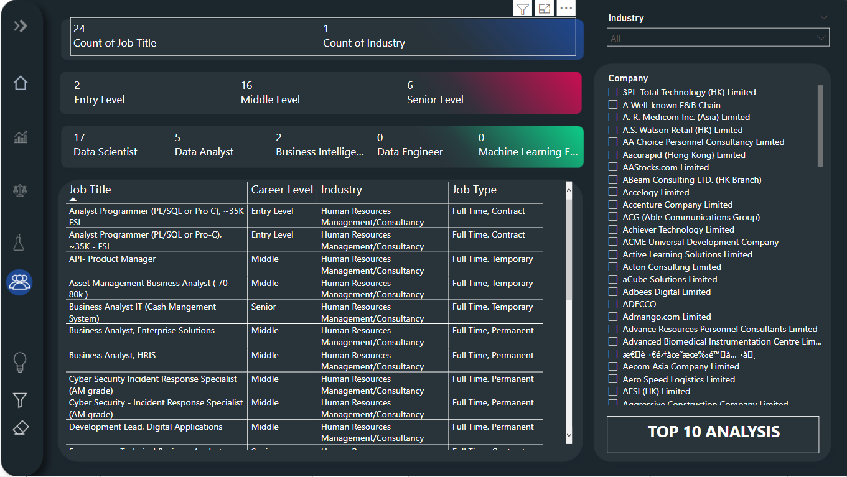
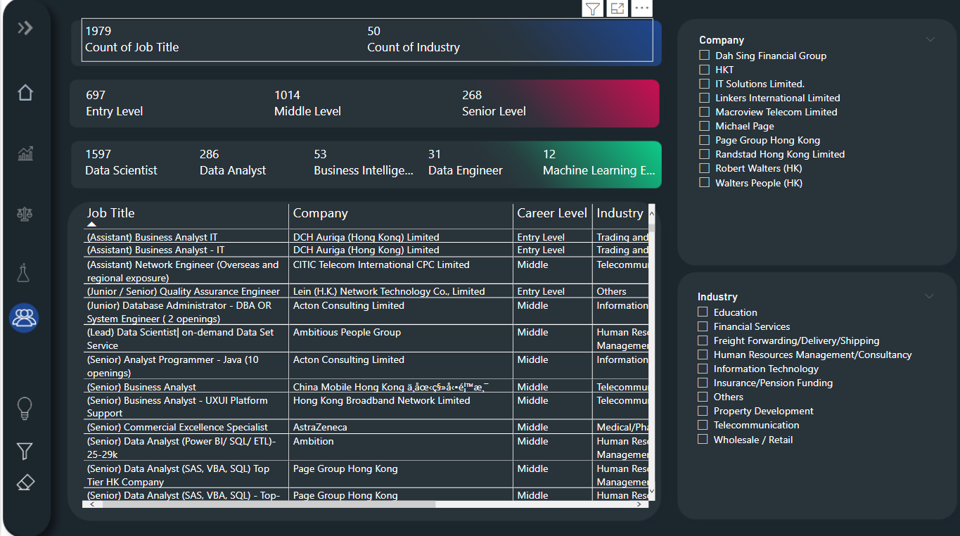
DASHBOARD PAGES VIEW
COMPANY LEVEL ANALYSIS PAGE
TOP 10 COMPANY LEVEL ANALYSIS PAGE

Slide 58

/
THANK YOU !
A very special thanks to Satyajit Sir for organizing this amazing contest.
CONTACT AND SOCIAL LINKS
Email: jaycharole@gmail.com
Contact: 9892968944

